Slide 1
Coursera Capstone Presentation:
Analyzing Locations for a New Bank in
London, Ontario, Canada
By Wacey Schell

Slide 2
Business Problem
Objective: To analyse and select the best location in London, Ontario, Canada for a bank to open a new location.
A bank and all of its services can be incredibly important to the structure of a healthy community’s economy
Choosing the right place to locate a bank is mutually beneficial to both a bank and a community
Business question: Where would be the best place in London, Ontario for a bank to open a new location

Slide 3


Data
Data required:
List of neighbourhoods in London, Ontario
Latitude and longitude of the neighbourhoods of London, Ontario
Data on banks in London, Ontario
Data Sources:
Wikipedia https://en.wikipedia.org/wiki/Category:Neighbourhoods_in_London,_Ontario
Geocoder package for latitude and longitude of neighbourhoods
Foursqaure API for venue data

Slide 4
Methodology
Obtaining list of London, Ontario neighbourhoods from wikipedia by web scraping
Obtaining latitude and longitude of neighbourhoods using Geocoder
Use Foursquare API to get venue data regarding banks in London, Ontario
Group data by neighbourhood:
taking the mean of the frequency of occurrence of each venue category
Filter venue category by bank
Perform k-means clustering on the data
Visualize the clusters on a map using folium

Slide 5
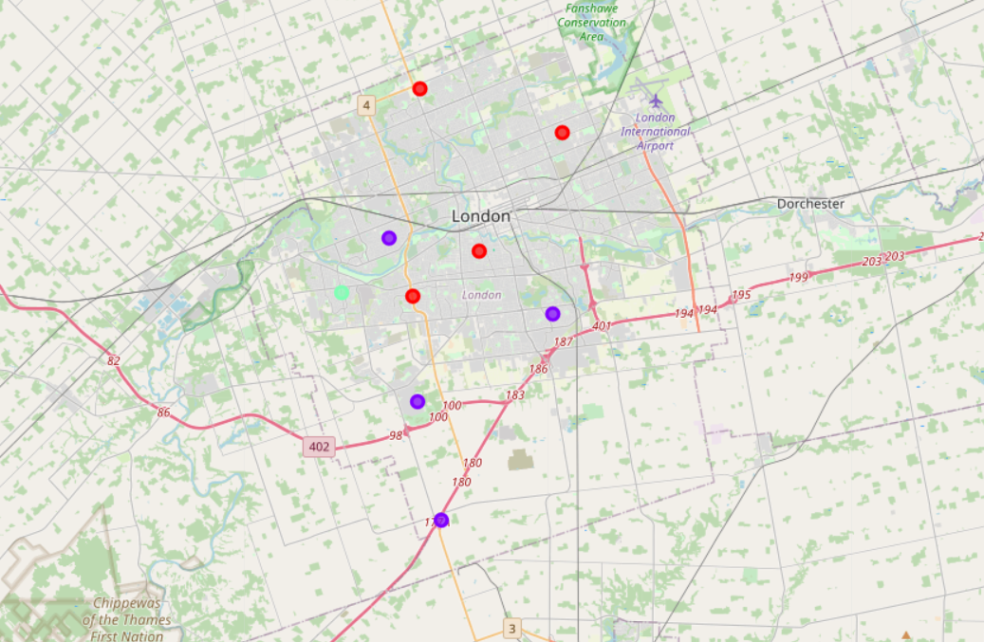
Results
Categorize the neighbourhoods into 3 clusters:
Red : Highest number of banks
Lime Green: Moderate number of banks
Purple: Lowest number of banks
Tip
Remember. If something sounds like common sense, people will ignore it.
Highlight what is unexpected about your topic.

Slide 6
Discussion
Most of the banks are concentrated in the central and north neighbourhoods of London
Neighbourhoods located in the south of London have less access to banks
adding a location within cluster located along the south may be a great opportunity for a bank because it could count on some potential business from rural communities outside of the city on their way into London along the 401 and 402 highways, which are two of Ontario's largest highways

Slide 7
Recommendations
Opening a bank within the south (purple) cluster of London where there are the least number of banks
Avoid opening a bank in neighbourhoods in the red cluster, as there are plenty of banks already

Slide 8

Conclusion
In this study, I analyzed the neighbourhoods of London, Ontario, Canada to determine the answer to the business question of where the best location to open a bank would be. I sorted the neighbourhoods of London into similar groups with respect to the occurrence of banks within them using a simple unsupervised machine learning algorithm, k-means clustering. Once this algorithm was run, it was easy to see which neighbourhoods had little to no banks available to them, which I decided to take as the main indicator for the best place for a new bank to open doors. According to our analysis, cluster 1 along the south part of London (see map above) was found to have the least amount of banks, and thus opening a bank within this region would be the most beneficial.

